Slide 1

BA 723 Capstone Project
Netflix: Stock prediction and forecast
By Justin Tay

Slide 2
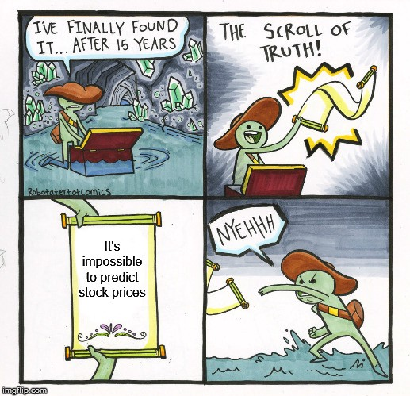
1) What is the risk of investing in the Netflix stock?
Investigated through Exploratory Data Analysis (EDA)
2) Can we reliably predict and forecast Netflix’s stock price using Time Series models?
If so, which model would be the most appropriate?
Questions posed

Slide 3

Data variables used
Part 1: EDA
Netflix historical Stock prices
Close
Open
High
Low
Nasdaq
Open
Close
High
Low
Unemployment Rate
US Federal Interest
External variables need to be considered to see if they cause change in stock prices
Data range from Jan 2017 to Nov 2021

Slide 4
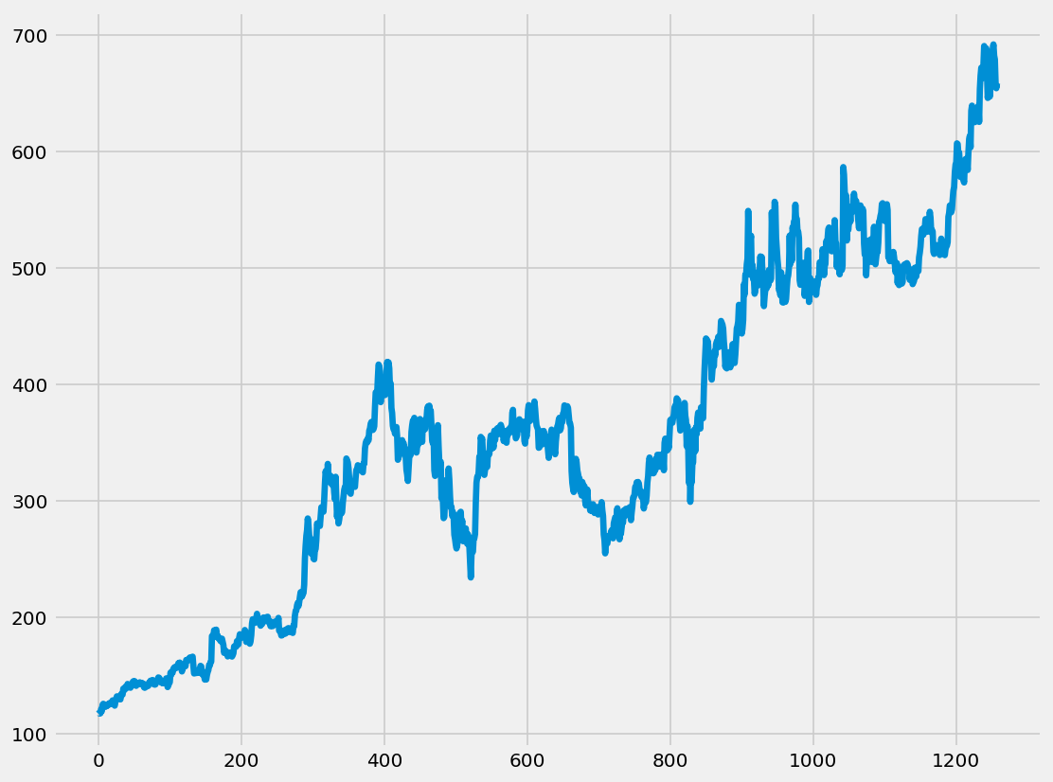
- Experiencing upward trend from 2017 to 2021 - However, is there more that meets the eye?
Netflix’s stock price trend

Slide 5
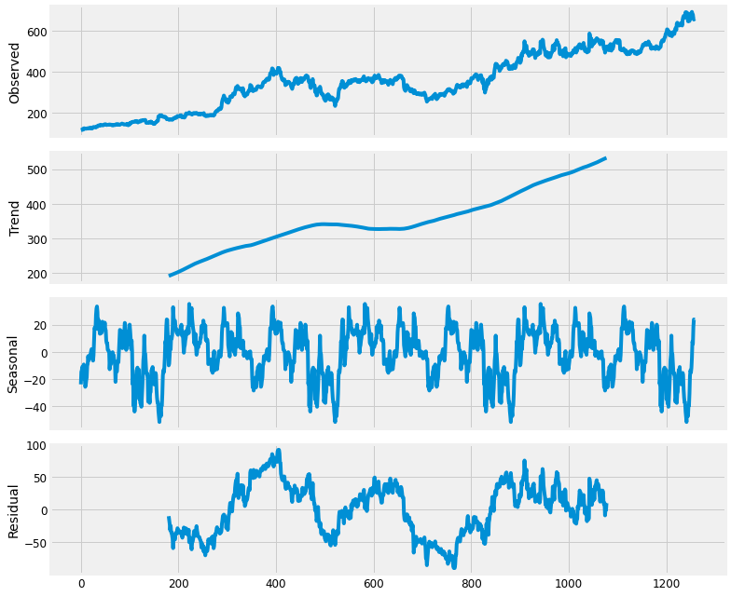
Seasonal Decomposition
Despite there being an upward trend in Netflix prices, there is a seasonal trend to the fluctuations of the price, which aids us greatly in our forecast for Netflix stock prices.
We can see a pattern in the rise and fall of Netflix stock price throughout the year

Slide 6
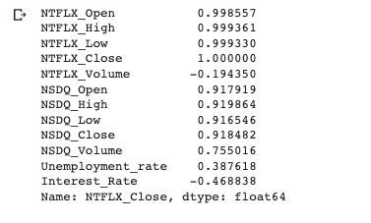
Correlation
Linear relationship as a number between -1 (negatively correlated) to 0 (not correlated) to 1 (perfectly correlated).
Using Pearson Correlation, we can see how Netflix Close price is high correlated with several variables
As Netflix High and Low variables are the most highly correlated, we will also use these variables for our Multivariate LSTM model

Slide 7
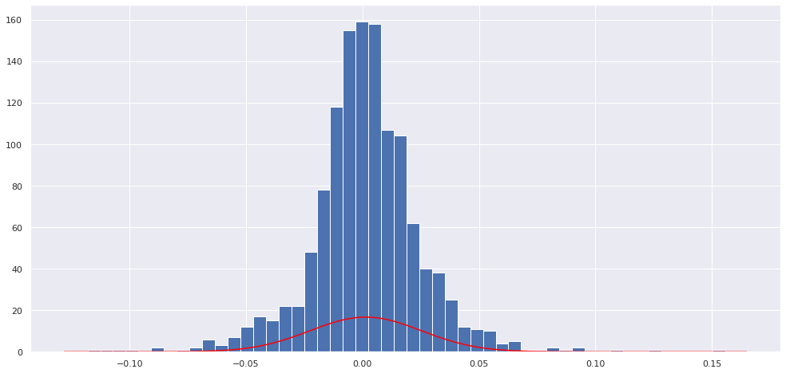
Stock Return
Stock return was calculated using Logarithmic Return
Probability of stock price dropping 10% in one day : 1.14
Single day value at risk: -0.038
The probability of dropping over 25% over a year: None
90% confidence level interval: 0.000265, 0.00248

Slide 8

Our simple calculation and predictions show that is nearly impossible that a price would drop during a day over 10% or during a year over 25%.
The amount of calculated value at risk and what we got from the confidence interval shows us that Netflix is a very safe investment.
Therefore, it would be recommended to invest in the Netflix stock

Slide 9
Part 2: Modelling
Modelling is essential to help us predict and forecast Netflix Stock price
Moving Average (MA)
AutoRegressive Integrated Moving Average (ARIMA)
Long short-term memory (LSTM)
MA and ARIMA models are Univariate
LSTM model is Multivariate
To determine which model is the most appropriate, it will be determined by using Mean Squared Error (MSE)
Mean Squared Error (MSE) is a measure of how close a fitted line is to data points. For every data point, you take the distance vertically from the point to the corresponding y value on the curve fit (the error), and square the value

Slide 10
50 day Moving Average
The more accurate a moving average is as a trend indicator, the more useful it is for traders and analysts.
The ideal moving average shows a level that price will not likely violate on a mere temporary retracement, thus possibly giving a false market reversal signal. It can also be used to place a trailing stop on an existing market position.
50 days Moving Average is the most commonly used model for traders and analysts

Slide 11
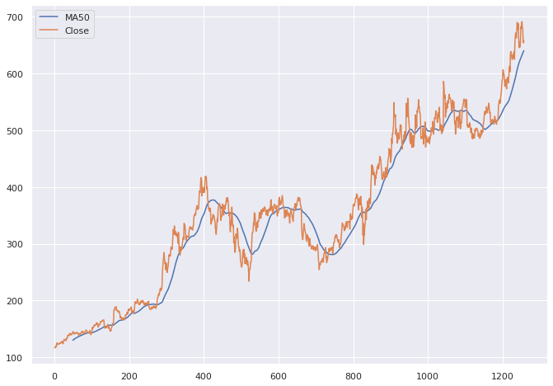
Moving Average (MA) for 50 days
MSE: $13.3

Slide 12
ARIMA model
ARIMA is an acronym that stands for AutoRegressive Integrated Moving Average.
This type of model is becoming a popular tool for data scientists to employ for forecasting future demand, such as sales forecasts, manufacturing plans or stock prices.
In forecasting stock prices, for example, the model reflects the differences between the values in a series rather than measuring the actual values

Slide 13
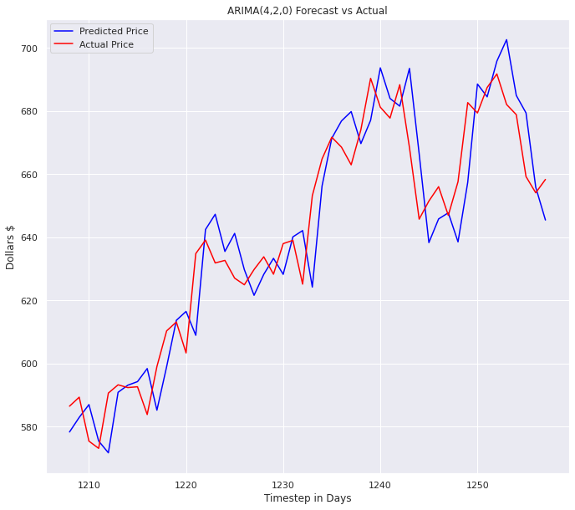
MSE: $11.86
An improvement from the previous model

Slide 14
LSTM
Long short-term memory (LSTM) is an artificial recurrent neural network (RNN) architecture used in the field of deep learning.
Multi-variate model as this can allow us to also take into account other closely correlated variables such as Netflix High and Low prices. These are also the variables we will use (which we could not use previously)

Slide 15
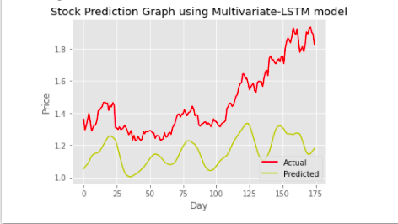
MSE: $0.12
Taking into account curse of dimensionality, LSTM model only used 3 variables, more variables might increase MSE

Slide 16
Summary
MA 50 days: $13.3
ARIMA:$11.86
LSTM: $0.12
Overall, the LSTM model has the least amount of error, and therefore would be the most appropriate model in this case

Slide 17
Conclusion
In the foreseeable future, we can invest in the Netflix stock knowing that there is very minimal risk involved
If we wish to predict and forecast Netflix stock prices, the LSTM model would be the most suitable

Slide 18
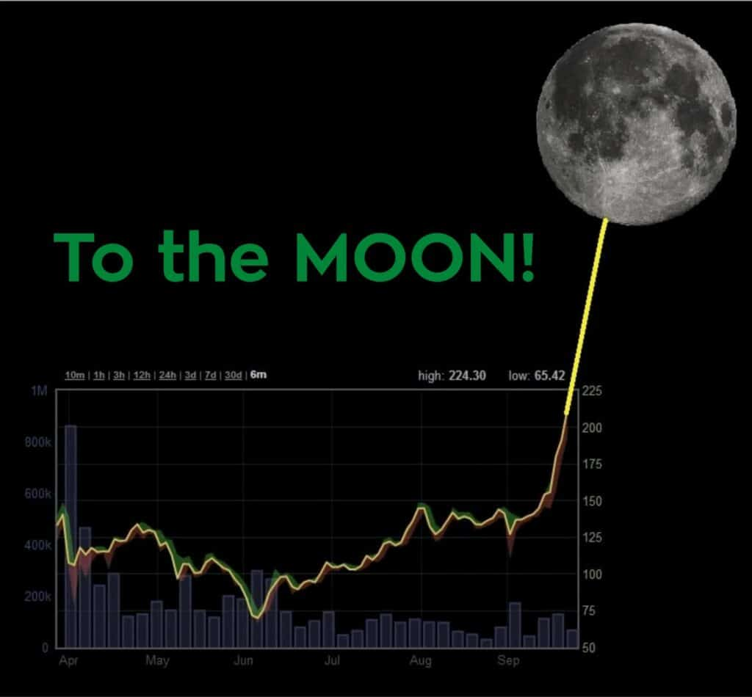
Thank you

Slide 19
Bilbiography
Netflix Historical Data taken from: https://finance.yahoo.com/quote/NFLX/history?p=NFLX NasDaq Historical Data taken from: https://finance.yahoo.com/quote/%5EIXIC?p=%5EIXIC
US Federal Interest Rate taken from: https://tradingeconomics.com/united-states/interest-rate
US Unemployment Rate taken from: https://tradingeconomics.com/united-states/unemployment-rate
Kiat, K. C. (2019, July 3). Financial analytics - exploratory data analysis of Stock Data. Medium. Retrieved December 13, 2021, from https://towardsdatascience.com/financial-analytics-exploratory-data-analysis-of-stock-data-d98cbadf98b9
Mitchell, C. (2021, December 7). How to use a moving average to buy stocks. Investopedia. Retrieved December 13, 2021, from https://www.investopedia.com/articles/active-trading/052014/how-use-moving-average-buy-stocks.asp
Phi, M. (2020, June 28). Illustrated guide to LSTM's and GRU's: A step by step explanation. Medium. Retrieved December 13, 2021, from https://towardsdatascience.com/illustrated-guide-to-lstms-and-gru-s-a-step-by-step-explanation-44e9eb85bf21
Prabhakaran, S. (2021, November 22). Arima model - complete guide to time series forecasting in python: ML+. Machine Learning Plus. Retrieved December 13, 2021, from https://www.machinelearningplus.com/time-series/arima-model-time-series-forecasting-python/

Slide 20
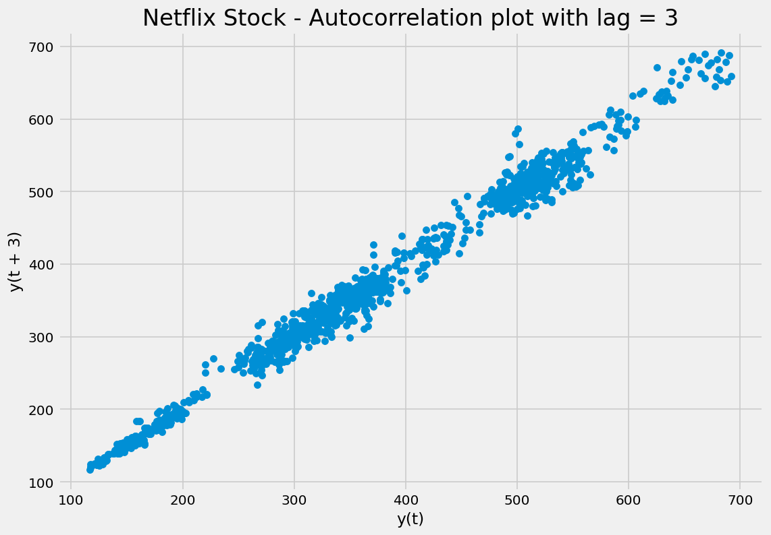
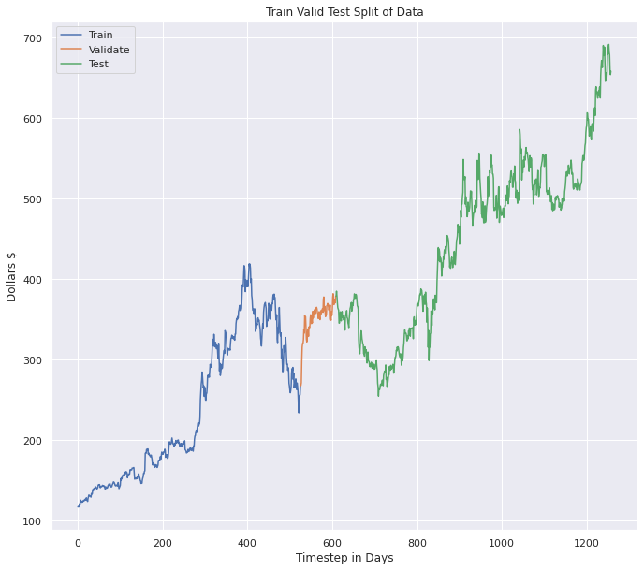
Index
1.1 Train, test and validating the dataset
1.2 Autocorrelation

Slide 21
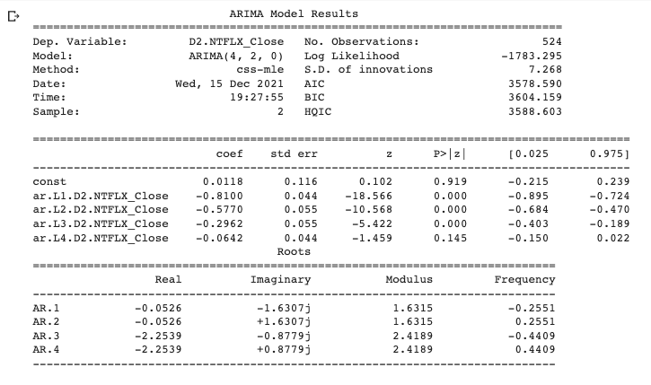
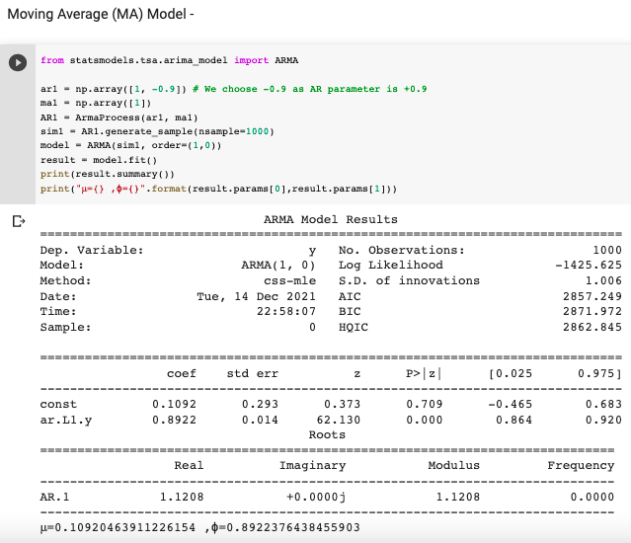
Index (cont.)
1.4 ARIMA statistics
1.3 Moving Average statistics

Slide 22
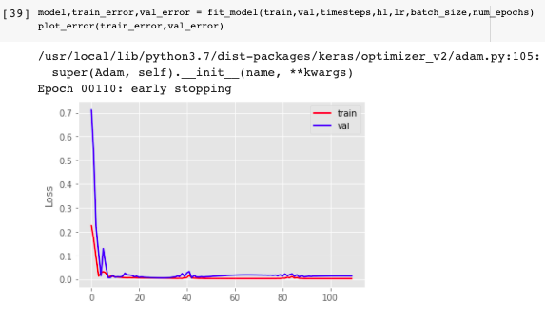
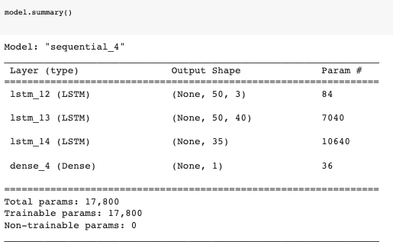
Index (Cont.)
1.5 Compiling LSTM model
1.6 Compiling LSTM model 2

